Slide 1
Information Processing and Inference in Large Social-Technological Networks
Chee Wei Tan
City University of Hong Kong
21 April, 2014
2014 IEEE ISSNIP Conference Tutorial
Singapore

Slide 2


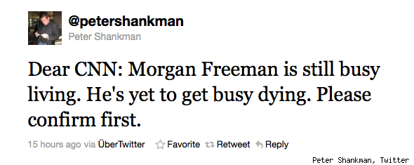
Motivation
Rumors
Source: Google

Slide 3
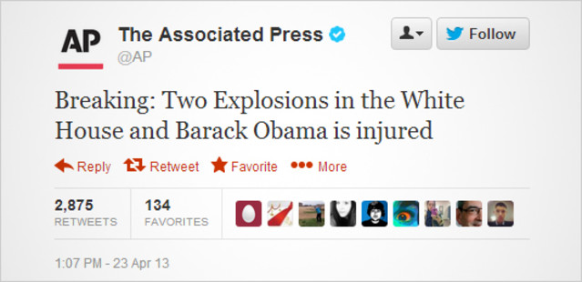
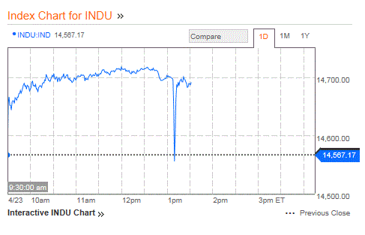
Motivation
Rumors
Source: Bloomberg

Slide 4
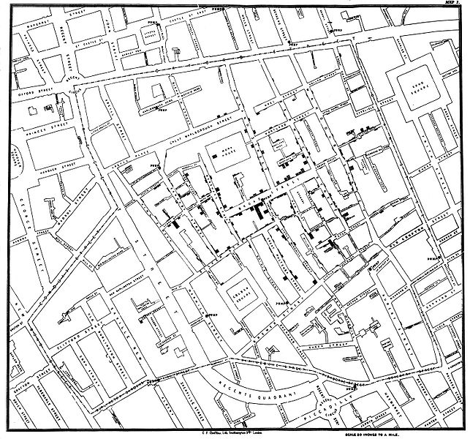
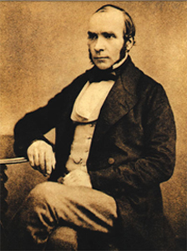

Motivation
1854 London Cholera Epidemic
Outbreak source
Dr. John Snow
Source: Wikipedia

Slide 5
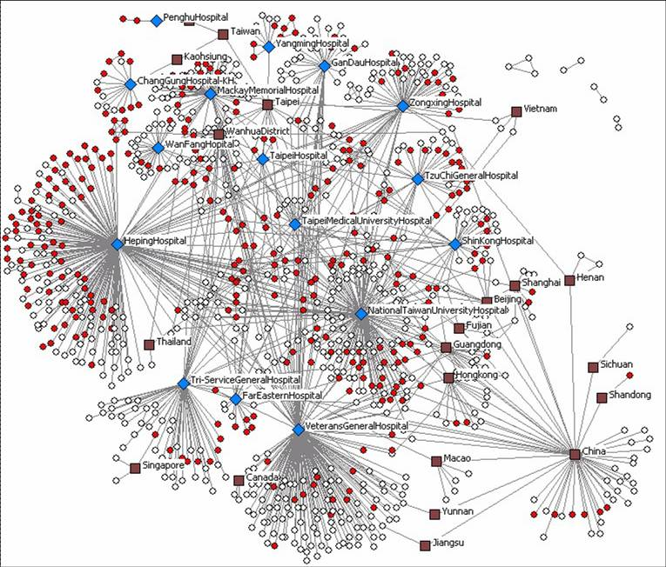
Motivation
2003 SARS (severe acute respiratory syndrome)
Source: The University of Arizona Artificial Intelligence Lab

Slide 6
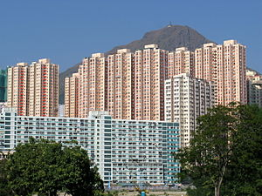

Motivation
2003 SARS Rumor
Rumor: “Entire City was poised to be quarantined”
14 year-old boy arrested for creating fake news page
Epicenter of
Hong Kong SARS
329 Infected
42 killed
Source: http://edition.cnn.com/2013/02/21/world/asia/hong-kong-sars-anniversary
Rumor and panic spread faster than virus. Nothing spreads like fear!

Slide 7
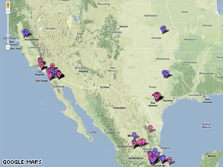
Motivation
2009 Online Flu Map Goes Viral
Created by Pittsburgh biochemist Harry Niman on April 21, 2009
Surpassing 290,000 web views and 3000 comments within 9 days
Source: http://edition.cnn.com/2009/TECH/04/30/online.flumaps/index.html

Slide 8
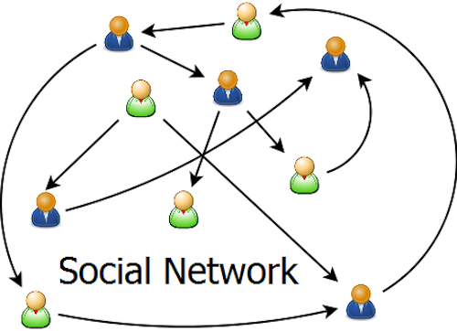


Motivation
Growth and Expansion of Online
Social Networks
Smartphone revolution 2007
Twitter 2006
Tencent Weixin 2012

Slide 9
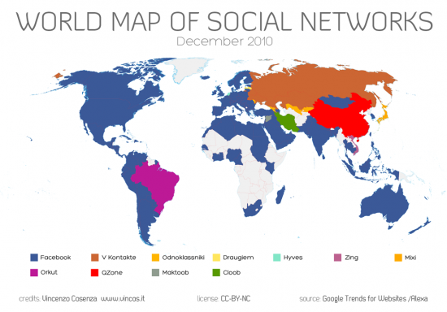
Motivation
Reach of Online Social Networks

Slide 10

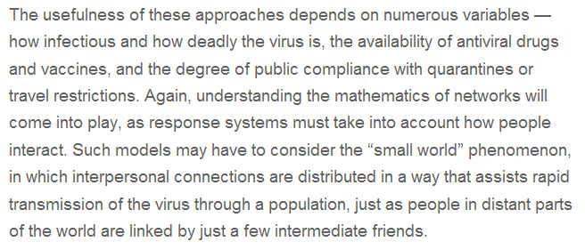
Motivation
National Grand Challenges
US National Academy of Engineering Grand Challenges 2008
Challenge No. 7: Advance health informatics

Slide 11
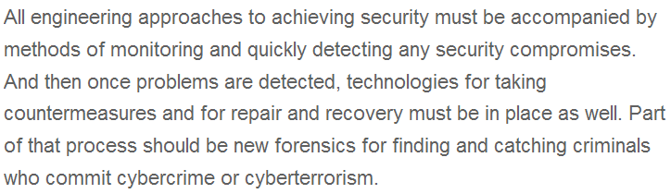
Motivation
National Grand Challenges
US National Academy of Engineering Grand Challenges 2008
Challenge No. 11: Secure Cyberspace

Slide 12

Motivation
DARPA Mathematical Challenges
23 Mathematical Challenges issued by US Defense Advanced Research Projects Agency (DARPA) in 2008
Challenge No. 2: The Dynamics of Networks
Challenge No. 14: An Information Theory for Virus Evolution - can Shannon’s theory shed light on this fundamental area?
Source: https://www.fbo.gov/download/9bc/9bce380aafb19f9ad3bda188bfc1ab20/DARPA-BAA-08-65.doc

Slide 13
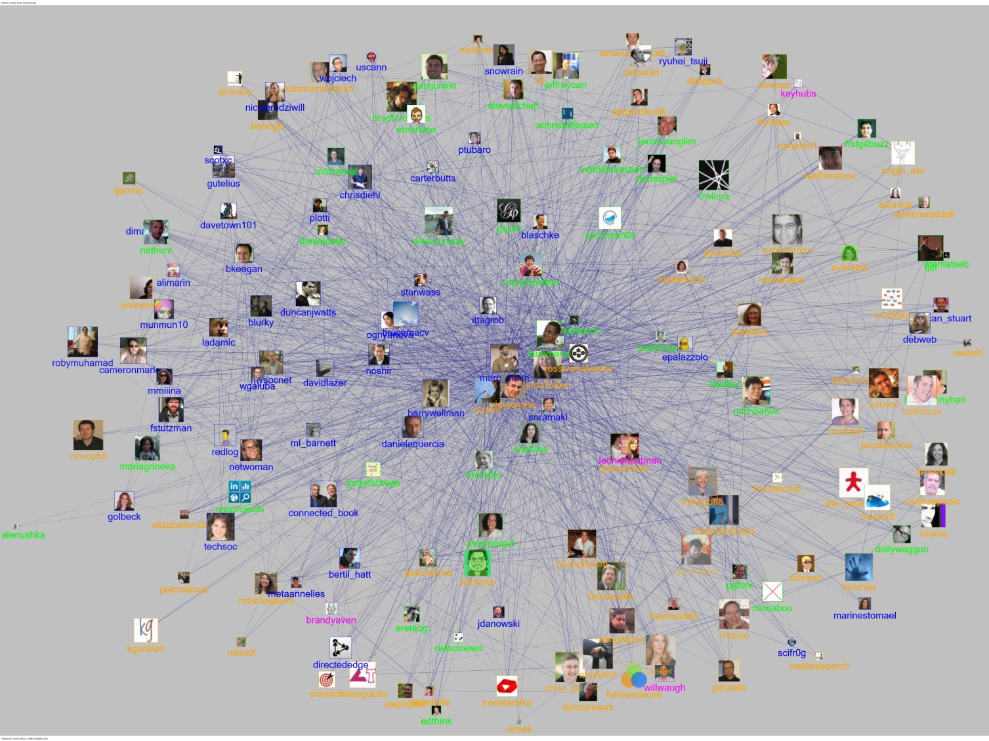
Rumor Spreading in Online Social Network
Outbreak of infectious virus
Diffusion of viral Information in Network
Cause of outbreak
Epidemic-like information flow = rumor spreading in a network.

Slide 14
Who is the culprit?
Spread of computer virus
Tweeting and Retweeting in Twitter Network
A rumor, originating from a suspect set, spreads on a network.
We only know the prior suspect set and infected nodes.
Can we find the single rumor source?

Slide 15
Literature ----Research on epidemic outbreak/rumor spreading
understand impacts of network structure and infection/cure rates
learn network parameters and predict propagation characteristics
extract influential source nodes
[Moore—PRE’00, Pastor-Satorras—PRL’01, Newman—PRE’02]
[Streftaris—IWSM’02, Okamura—ISSRE’07, Gomez-Rodriguez—SIGKDD’10]
[Kempe—SIGKDD’03, Chen—SIGKDD’09, Dong—Allerton’12]
Rumor source estimation problem has only been recently studied.

Slide 16
Literature ----estimation of rumor source
identification of single rumor source using SI model
geometric trees, random graphs
identification of multiple rumor sources (SI model), identification of single rumor source (SIR model)
noisy estimation of a single rumor source
[Shah—TIT’11, Shah—SIGMETRICS’12]
[Shah—arXiv’11, Shah—TIT’11]
[Luo—TSP’13, Zhu—ITA’13]
[Pinto—PRL’12]
Important features such as suspects, no. of observations, topology has not been considered.

Slide 17
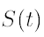
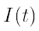
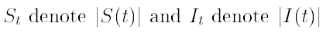
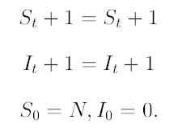
SI Spreading Model (Kermack & McKendrick 1927)
Fixed Population N (only one infected at each t)
Susceptible Set at time t
Infected Set at time t
Notes:
17

Slide 18
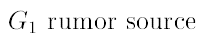
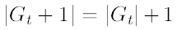
SI Spreading Model
Vertex of a graph to model the susceptible and the infected node (person)
An edge in models the relationship between two nodes
Two persons connected as Facebook Friends or Twitter Follower
Notes:
18

Slide 19
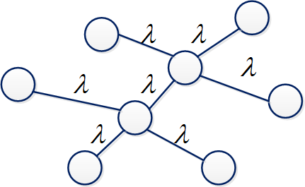
Random SI Model for Rumor Spreading
SI (susceptible-infectious) model
An infected node keeps the rumor forever
Uniform probability of any node in a prior suspect set being source
consists of suspect nodes
Time to infect neighbor is independent and exponentially distributed with rate λ
[Shah—TIT’11, Shah—SIGMETRICS’12]
Tan—ISIT’13, SIGMETRICS’14]

Slide 20
Deterministic SI Model
Time to infect neighbor is assumed to be a fixed time-slot
A susceptible node is infected by each of its neighbors with probability q
Assuming the number of infected neighbors of a susceptible node is n, the probability that the node becomes infected is
Time-slot model used by researchers for network inference
[Luo—TSP’13, Zhu—ITA’13]

Slide 21
Inference with Single Snapshot Observation
Toy Example
Notes:
21

Slide 22
Toy Example
Counts the number of permitted permutation to spread a rumor
Notes:
22

Slide 23
Toy Example
Suppose Source 1
Two permutations: {1,2,3,4}, {1,2,4,3}
Suppose Source 2
Six permutations: {2,1,3,4}, {2,1,4,3},{2,3,1,4}, …
[Shah—TIT’11]
Notes:
23

Slide 24
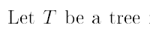
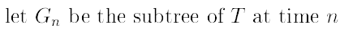
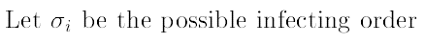
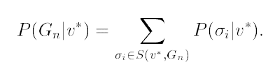
Inference in Tree
S
C
d
d
S
Notes:
24

Slide 25
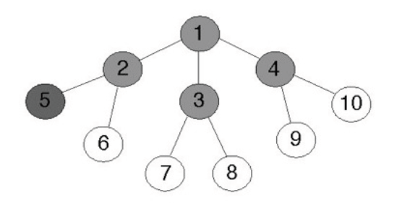
Toy Example
Notes:
25

Slide 26
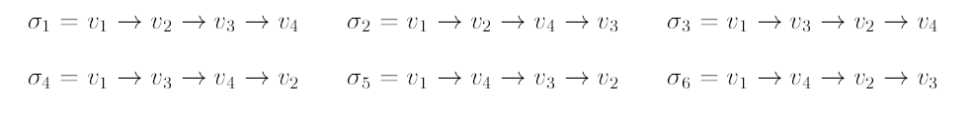
Toy Example
Suppose Node 1 is Rumor
Notes:
26

Slide 27
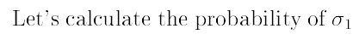
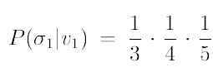
Toy Example
Suppose Node 1 is Rumor
Notes:
27

Slide 28
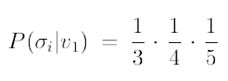
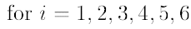
Toy Example
Suppose Node 1 is Rumor
Notes:
28

Slide 29
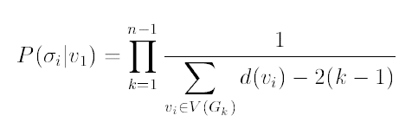
General Tree
Notes:
29

Slide 30
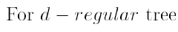
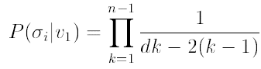
General Degree-Regular Tree
Notes:
30

Slide 31
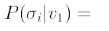
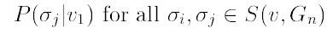
Toy Example
Suppose Node 1 is Rumor
Notes:
31

Slide 32
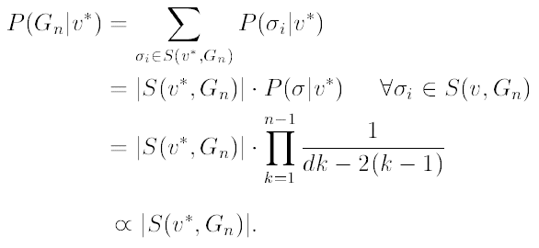
Toy Example
Suppose Node 1 is Rumor
Notes:
32

Slide 33
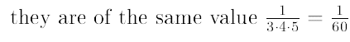
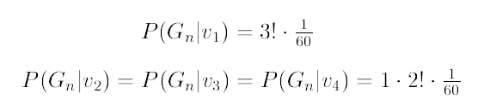
Toy Example
Suppose Node 1 is Rumor
The Node with the Maximum Likelihood:
Notes:
33

Slide 34
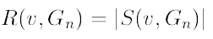
Rumor Centrality
Shah and Zuman
IEEE Transactions on Information Theory 2011
Rumor centrality counts the number of permitted permutation to spread a rumor
Notes:
34

Slide 35
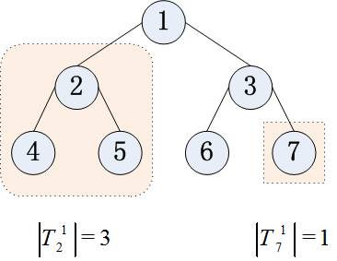
Rumor Centrality
Shah and Zuman
IEEE Transactions on Information Theory 2011
Rumor centrality counts the number of permitted permutation to spread a rumor
Notes:
35

Slide 36
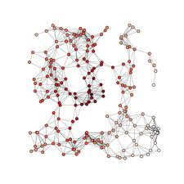
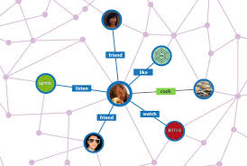
Rumor Center
[Shah—TIT’11]
ML (maximum likelihood) estimator
Most likely source is at the “center” of the network!
Notes:
36

Slide 37
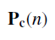
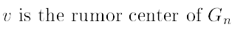
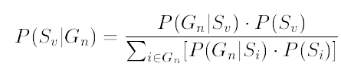
Detection Probability
Detecting the most probable source by Bayes Theorem
=
Notes:
37

Slide 38
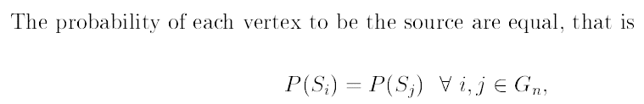
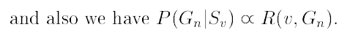
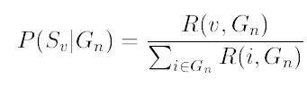
Detection Probability
Detecting the most probable source by Bayes Theorem
=>
Notes:
38

Slide 39
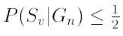
Detection Probability
Bound
Shah and Zuman
IEEE Transactions on Information Theory 2011
Notes:
39

Slide 40
Detection Probability
Bound
Shah and Zuman
IEEE Transactions on Information Theory 2011
Notes:
40

Slide 41


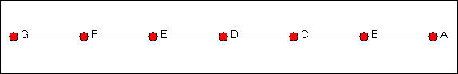
Minimum Detectability
Line Network is undetectable!
Can multiple observations help?
Notes:
41

Slide 42

Minimum Detectability
For finite n
Notes:
42

Slide 43


Minimum Detectability
For asymptotically large n
Stirling’s asymptotic formula:
Notes:
43

Slide 44
Detectability
Degree-regular tree with degree strictly larger than 2 is asymtotically detectable
Phase-Transition like phenomenon!
Notes:
44

Slide 45

Connection with Graph Convexity in Graph Theory
Shah and Zuman
IEEE Transactions on Information Theory 2011
Recall that
Notes:
45

Slide 46


Connection with Graph Convexity in Graph Theory
Since
Notes:
46

Slide 47



Alternative Characterization of Rumor Cente
Shah and Zuman
IEEE Transactions on Information Theory 2011
Notes:
47

Slide 48



Connection with Graph Theory
Distance Centrality (Social Network Analysis)
where is is the shortest path length between v and j (eccentricity)
Vertex in with minimum distance centrality is called distance center
Distance from 1 to all shaded nodes:
From Node 1 to Node 2: 1
From Node 1 to Node 3: 2
From Node 1 to Node 4: 2
Distance Centrality of Node 1 = 1+2+2=5
Distance Centrality of Node 2 is 3, therefore Node 2 is Distance Center
Notes:
48

Slide 49


Connection with Graph Theory
Mass of graph (Graph Theory)
Vertex in with minimum weight is called mass center
Subtree of a child (Node 2) of Node 1 has size of 3
Weight of Node 1 = 3
Weight of Node 2 is 1 for its three subtrees, therefore Node 2 is Mass Center
Notes:
49

Slide 50

Connection with Graph Theory
Notes:
50

Slide 51
Connection with Graph Theory
A tree has either exactly one or two mass centers (graph theory result)
There are at most two rumor centers when the maximum subtree tree is n/2 (Shah’s IT result)
Notes:
51

Slide 52
Algorithms
A myriad of polynomial-time algorithms for computing rumor center
Mass center algorithm (graph theory)
Distance center algorithm (social network analysis)
Message passing algorithm (Shah’s IT result)
…etc
Notes:
52

Slide 53

Detection with Suspects
Why consider suspects?
Not all infected are suspects
spread of infectious disease from cities to cities
(frequent travellers)
infection of rumors or computer viruses in cyberspace
(vulnerable hosts)
Suspect characteristics significantly affect detectability and add an interesting dimension to identifying the source reliably.

Slide 54

Detection with Suspects
What’s new with suspects?
Finite regime:
at most vs. at least 0.5 detection probability
Asymptotic regime:
0.307 vs. 1 best detection probability
Insightful monotonicity and averaging results
Dong, Zhang and Tan
Proc. of IEEE Symposium on Information Theory 2013
Zhao, Dong, Zhang and Tan
ACM SIGMETRICS 2014
Notes:
54

Slide 55






Detectability
Detectability is graph constrained. Network connectivity matters!
Notes:
55

Slide 56
MAP Rumor Source Estimator
MAP (maximum a posteriori) estimator
A prior suspect set
An observation of infected nodes

Slide 57
MAP Rumor Source Estimator
For regular tree-type networks
For general tree-type networks
For general networks
optimal MAP estimator
focus on regular trees
Analyze the correct detection probability upon observing n infected nodes

Slide 58


Detectability on Tree
How to detect on a tree?
Can fewer number of infected nodes help detectability?
Can a higher degree help detectability?
Notes:
58

Slide 59

Pólya’s Urn Model
Joint distribution
Marginal distribution
Limit distributions
[Johnson—JWS’97]

Slide 60



Equivalence to Pólya’s Urn Model
Rumor spreading process
Ball drawing process

Slide 61

Suspecting all Nodes ----main results
Case 1
Main results
Any infected node might be the rumor source.
node degree
node degree
node degree
Monotonicity: Detection probability increases with degree and decreases with n
[Shah—TIT’11, Shah—SIGMETRICS’12]
The detection probability is asymptotically upper bounded by 0.307.

Slide 62
Minimum Detectability
Line Network is undetectable!
Can multiple observations help?
Notes:
62

Slide 63
Suspecting all Nodes ----validation experiment

Slide 64

Connected Suspects ----main results
Case 2
Main results
All suspect nodes form a connected subgraph.
node degree
node degree
node degree
Monotonicity: Detection probability increases with degree and decreases with n
The performance is significantly improved and reliable detection can be achieved.

Slide 65
Connected Suspects ----validation experiment

Slide 66
Connected Suspects ----with vs. without prior knowledge
Closer-up look at case 2
Comparison with case 1
node degree
exceed prior probability
at least 0.5-detection
achieve reliable detection
node degree
non-trivial positive value
at most 0.5-detection
upper-bounded by 0.307
Suspect characteristics (connectivity) bring about new ingredients.

Slide 67

Connected Suspects ----no degeneration with large k
Averaged by Bayes’ Rule
Explanation
Suspect nodes nearby the subgraph boundary are easier to identify.
Suspect nodes inside the connected subgraph are harder to identify.
infinite regular-tree network
The results in case 2 don’t degenerate to case 1 with large k.

Slide 68

Connected Suspects ----validation experiment

Slide 69

Two Suspects ----main results
Case 3
Main results
Two suspect nodes is separated by d.
node degree
node degree
Monotonicity: Detection probability increases with d
Identifying the rumor source is more difficult if the two suspects are closer.

Slide 70
Two Suspects ----validation experiment

Slide 71

SIR Spreading Model
Fixed Population N (only one infected at each t)
Susceptible Set at time t
Infected Set at time t
Recovery Set at time t
Different parameter configuration with infectious rate and recovery rate
Notes:
71

Slide 72


Maximum Likelihood Estimator in SIR Spreading
Sample-path analysis
Jordan center (graph theory) of a graph is the set of all vertices of minimum eccentricity
Used for single-source and multiple-source detection
[Luo—TSP’13, Zhu—ITA’13]
Notes:
72

Slide 73
Detection for General Tree
Still an open problem
Each permitted permutation does not have equal probability
Breadth-First-Search (BFS) Heuristic Algorithm
Rumor centrality algorithm on BFS tree
Notes:
73

Slide 74
Detection for General Graph
Still an open problem
How to deal with loops?
Breadth-First-Search (BFS) Heuristic Algorithm
BFS tree approximates diffusion tree
Rumor centrality algorithm on BFS tree
Notes:
74

Slide 75




Detection for General Graph
Maximum Likelihood Estimator:
where
Notes:
75

Slide 76


Detection for General Graph
Toy Example for Regular Lattice Graph
Notes:
76

Slide 77


Detection for General Graph
Toy Example for Regular Lattice Graph
Notes:
77

Slide 78


Detection for General Graph
Toy Example for Regular Lattice Graph
Special case (Fully connected graph)
Notes:
78

Slide 79


Detection for General Graph
Erdos-Renyi random graph (N=50, K=20, p=0.4)
Actual Rumor Source
Rumor Center
Notes:
79

Slide 80

Detection for General Graph
Erdos-Renyi random graph
Actual Rumor Source
Rumor Center
Notes:
80

Slide 81

Detection for General Graph
Newman-Watts small world (N=50, K=20, m0=4, p=0.4)
Actual Rumor Source
Rumor Center
Notes:
81

Slide 82

Detection for General Graph
Newman-Watts small world graph
Actual Rumor Source
Rumor Center
Notes:
82

Slide 83


Detection for General Graph
Barabasi-Albert scale-free graph (N=50, K=20, m0=4,m=2)
Actual Rumor Source
Rumor Center
Notes:
83

Slide 84

Detection for General Graph
Barabasi-Albert scale free graph
Actual Rumor Source
Rumor Center
Notes:
84

Slide 85
Extensions
Detection with Multiple Observations
How many observations to take?
2 Observations more than double the detectability performance of a single observation
Open Questions
General graph detection
How good or how bad is the Breadth-first Search Heuristic?
Zhao, Dong, Zhang and Tan
ACM SIGMETRICS 2014
Notes:
85

Slide 86
Extensions
Centrality in Social Network Analysis
Degree
Distance
Betweenness
Eigenvector
…etc
Center in Graph Theory
Mass, Jordan
General unifying link still missing
Jordan center not equal to mass center in general
Notes:
86

Slide 87





Data Mining and Network Forensics
Forensics in Online social networks

Slide 88
Data Mining and Network Forensics
Many interactions over online social networks that are recorded and available from API service to glimpse social relationship of users
Provide clues for rumor source detection and other cyber-security forensics algorithms
How to even obtain a single snapshot observation of the graph?
Bridge deep gulf between theory and practice
There is nothing more practical than a good theory!

Slide 89

Facebook Graph
Enables application to read/write on Facebook social graph

Slide 90
Facebook Graph
Example API call (in Javascript)
FB.api(
"/me/friends?fields=id",
function (response) {
if (response && !response.error) {
/* handle the result */
}
}
);
90

Slide 91

Facebook Graph
API calls require access token
For identification of users, apps etc,
For granting permission, web login etc
Facebook query language
Query data from the Graph API (SQL-style interface)
e.g.
SELECT uid1, uid2 FROM friend where uid1 in ' + user1 + ' AND uid2 in ' + user2 + ' AND uid1 < uid2';
91

Slide 92

Data Mining
Rate-constrained data scraping
Access control for privacy and security
How to use semantics to infer possessing a rumor?
How to link social graph with technological graph?
92

Slide 93
Conclusion
Rumor Centrality
Center of a Network
Network features: Suspects, Connectivity, Observations
Detectability and Detection
Statistical inference, probability theory, graph theory, Information theory
Scalable algorithms
Numerous Open Issues:
Heterogeneous connectivity and spreading models
Real-world data traces
Practical network forensics protocol in online social networks

Slide 94
Thank You
cheewtan@cityu.edu.hk
www.cs.cityu.edu.hk/~cheewtan

Slide 95
SI Spreading Model
Notes:
95

